Slide 1
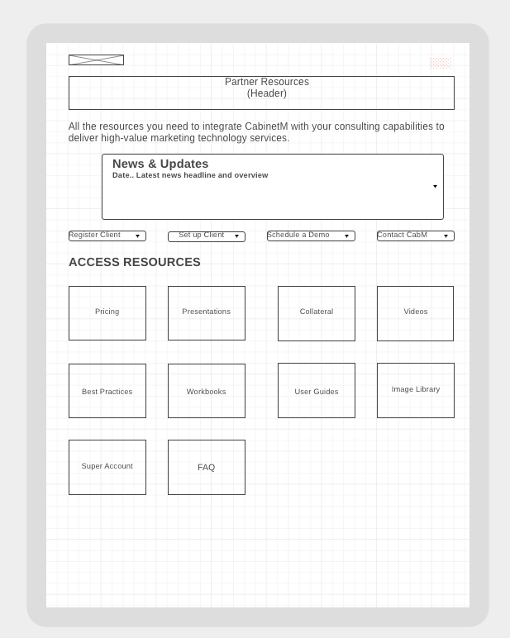
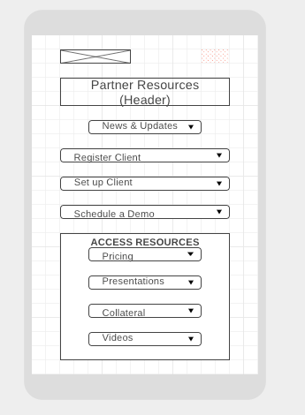
Phone
Tablet
Hamburger menu
Key CabinetM.com links
LOGO
Hamburger menu
ContactUs
Key CabinetM.com links
This layout would apply in both landscape and portrait mode.
Images would follow those on the desktop page and be clickable
Resource menu would continue on as user scrolls
https://wireframe.cc/r86TmP

